Slide 1
Symbol Tuning Benchmark

Slide 2
Symbol tuning
Change labels to numbers.
Trying to not mention anything related to ‘important’ or ‘not important’ tags in the prompt.

Slide 3
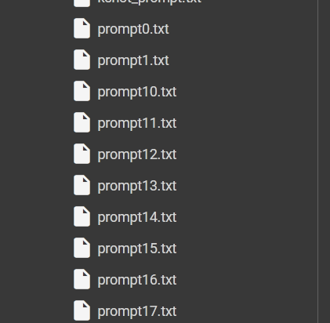
Symbol tuning
Cleaned the code.
Saving each prompt for more analyses.

Slide 4
Symbol tuning
First step:
Change the labels ‘1’s to ’58’s.
Change the labels’0’s to ‘47’s.
We tried to use labels that the model hasn’t seen.
So, it doesn’t use its’ predefined knowledge to tag news with ‘important’ or ‘not important’ tags.

Slide 5
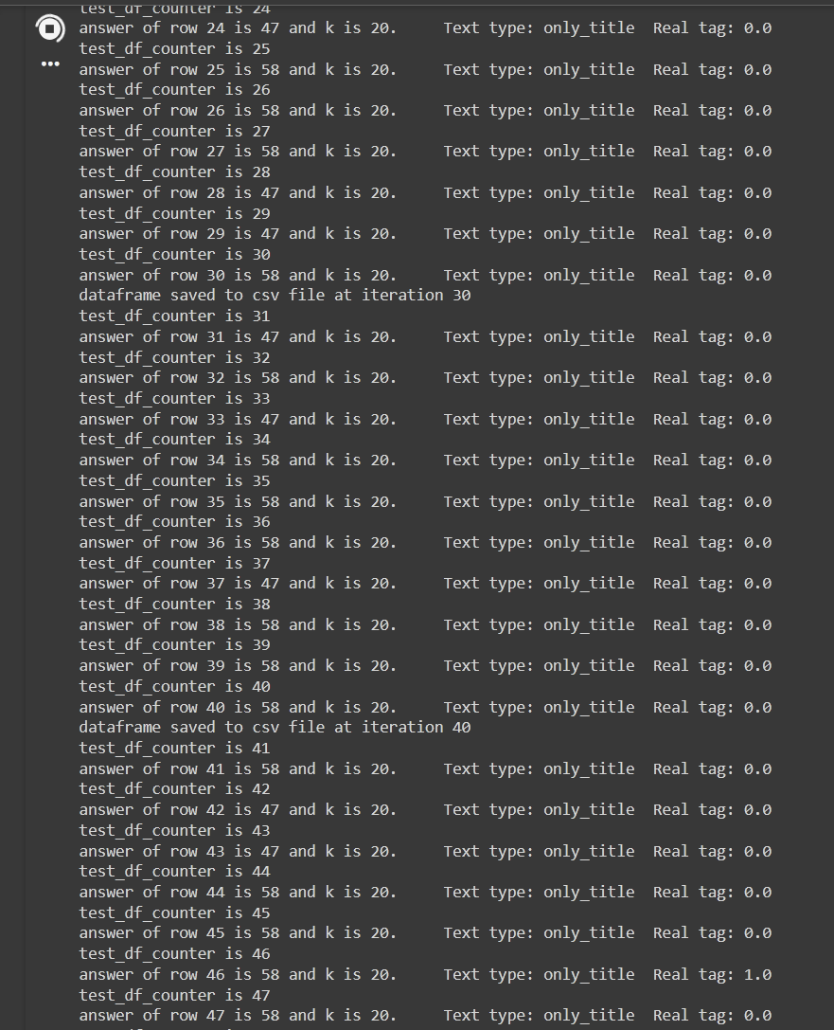
Symbol tuning
Surprisingly the Aya LLM tends to generate ‘58’ more than ‘47’ ones.
This might because there is more details or definition defined about ’58’ label.
Or this might be caused by ’58’ being the first label.
Or the dataset being imbalanced!
The result shown is in ‘k=20’ mode.

Slide 6
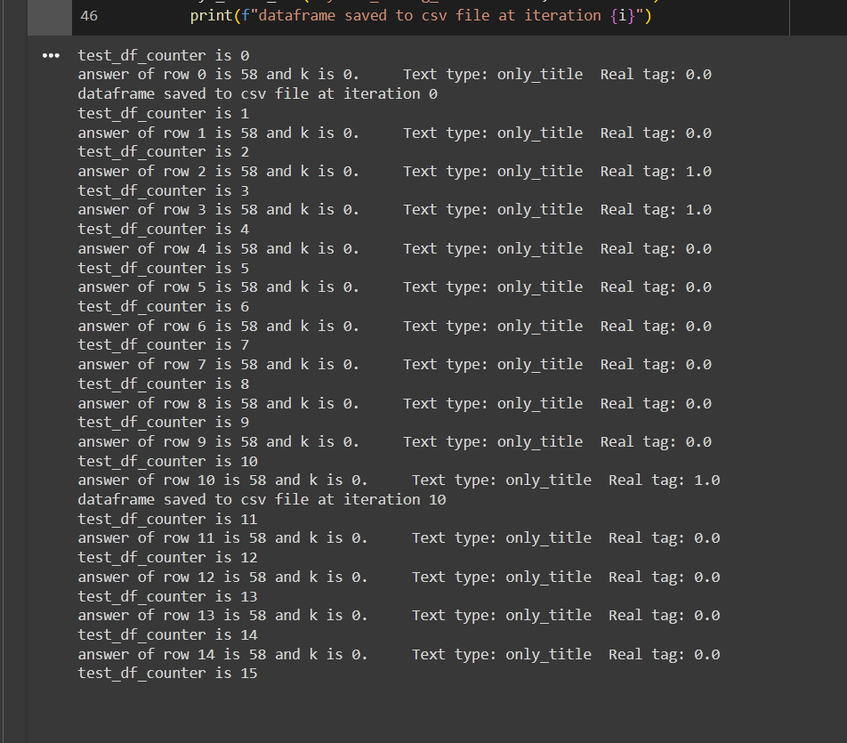
Symbol tuning
The result shown here is with k=0 shot prompts.
The model only generates ‘58’ as an answer!
We can interpret two things from the observation:
First the k shot example help the model to obtain knowledge about ‘47’ labels therefore resulting to predict some titles as ‘not important’ or ’47’.
Second, we should include in prompt what is ‘not important’ or ‘47’ label, only including information about what is known as ‘important’ result in generating only ‘important’ labels.

Slide 7
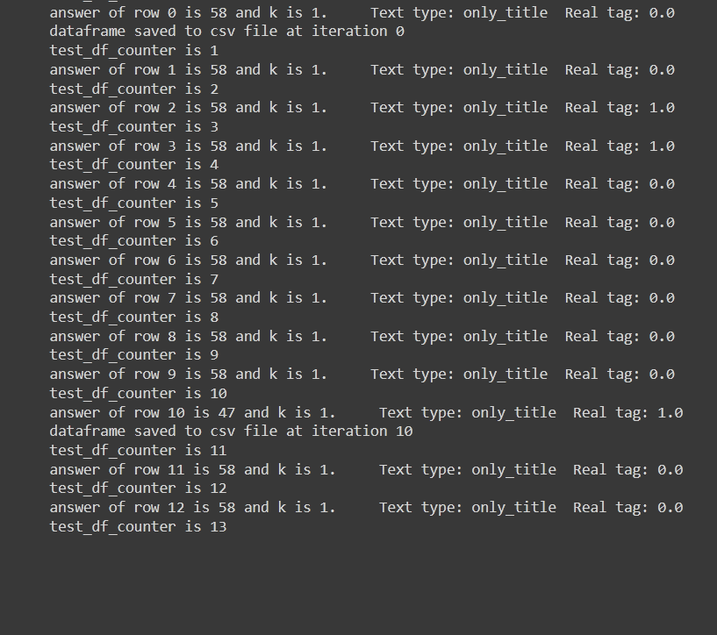
Symbol tuning
The result shown here is with k=1 shot prompts.
The model generates ’47’ labels sporadically.
This means that one example provided in the prompt was not enough to give the model enough information to predict more labels as ’47’.
But it shows that even providing one example can change the output!

Slide 8
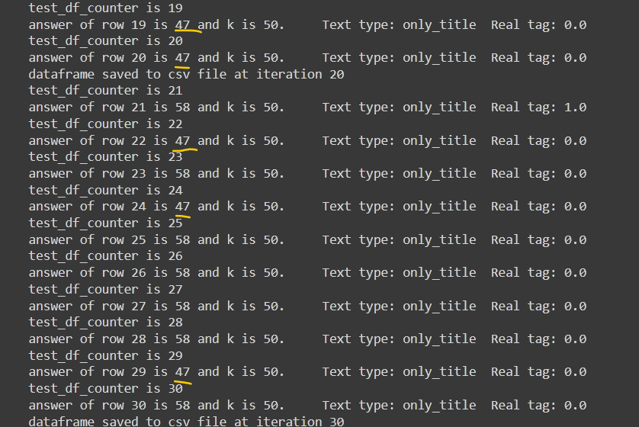
Symbol tuning
The result shown here is with k=50 shot prompts.
The model generates more ’47’ labels.
The results shows that the information and details about the ‘not important’ news is a necessity to override LLM predefined knowledge.

Slide 9
Symbol tuning
The challenge to make predictions more accurate is to include clear definition and details for both ‘important’ and ‘not important’ news.
This causes the language model to rely more on the information given in the prompt (or, as we know, in-context learning) rather than on its prior knowledge.

Slide 10
Symbol tuning results
Results for k = 0 shot learning:
The shown results is for first 101 entities in test data.
K = 0 | Accuracy | Precision | Recall | F1-Score | # of ’58’ | # of ’47’
Title | 17% | 14% | 93% | 24% | 96 | 5

Slide 11
Symbol tuning results
Results for k = 1 shot learning:
The shown results is for first 101 entities in test data.
K = 1 | Accuracy | Precision | Recall | F1-Score | # of ’58’ | # of ’47’
Title | 48% | 19% | 86% | 31% | 63 | 38

Slide 12
Symbol tuning results
Results for k = 5 shot learning:
The shown results is for first 101 entities in test data.
K = 5 | Accuracy | Precision | Recall | F1-Score | # of ’58’ | # of ’47’
Title | 47% | 16% | 64% | 25% | 58 | 43

Slide 13
Symbol tuning results
Results for k = 20 shot learning:
The shown results is for first 101 entities in test data.
K = 20 | Accuracy | Precision | Recall | F1-Score | # of ’58’ | # of ’47’
Title | 49% | 15% | 57% | 24% | 54 | 47

Slide 14
Symbol tuning results
Results for k = 50 shot learning:
The shown results is for first 101 entities in test data.
K = 50 | Accuracy | Precision | Recall | F1-Score | # of ’58’ | # of ’47’
Title | 55% | 17% | 57% | 26% | 47 | 54

Slide 15
Symbol tuning results

Slide 16
Symbol tuning feasible improvements
Possible future improvements:
Change the prompt: The problem observed here is that the prompt lacks a definition for ‘important’ news but details and definitions for ‘not important’ ones.
Changing the ‘important’ label to something that is harder to generate because our dataset is imbalanced, and we have little ‘important’ news compared to ‘not important’ ones. Therefore, it is logical to make the ‘important’ label harder to generate for the LLM model.
Including in the prompt that we have way less ‘important’ news than ‘not important’ ones; therefore, the model should be more sensitive and conservative in generating the ‘important’ label.
Including the chain of thoughts context with the examples provided in the prompt to make the decision for the model more logical and with more reasoning information.

Slide 17
Symbol tuning results
Here, we analyze the results achieved from the first 400 indices from our test dataset.
The number of total '1' labels is 77, and for '0' labels is 323.
# of ‘1’ labels | # of ‘0’ labels
77 | 323

Slide 18
Symbol tuning results
Results for k = 0 shot learning:
The shown results is for first 400 entities in test data.
The high percentage achieved by the model in recall metrics is due to mostly predicting '58' labels.
K = 0 | Accuracy | Precision | Recall | F1-Score | # of ’58’ | # of ’47’
Title | 21% | 19% | 97% | 32% | 387 | 13

Slide 19
Symbol tuning results
Results for k = 1 shot learning:
The shown results is for first 400 entities in test data.
K = 1 | Accuracy | Precision | Recall | F1-Score | # of ’58’ | # of ’47’
Title | 53% | 24% | 69% | 36% | 218 | 182

Slide 20
Symbol tuning results
Results for k = 5 shot learning:
The shown results is for first 400 entities in test data.
Highest f1-score reached!
K = 5 | Accuracy | Precision | Recall | F1-Score | # of ’58’ | # of ’47’
Title | 49% | 24% | 78% | 37% | 249 | 151

Slide 21
Symbol tuning results
Results for k = 20 shot learning:
The shown results is for first 400 entities in test data.
K = 20 | Accuracy | Precision | Recall | F1-Score | # of ’58’ | # of ’47’
Title | 48% | 23% | 71% | 34% | 242 | 158

Slide 22
Symbol tuning results
Results for k = 50 shot learning:
The shown results is for first 400 entities in test data.
Highest number of ’47’ predicted!
K = 50 | Accuracy | Precision | Recall | F1-Score | # of ’58’ | # of ’47’
Title | 57% | 25% | 61% | 35% | 188 | 212

Slide 23
Symbol tuning results

Slide 24
Symbol tuning results

Slide 25
Symbol tuning results
Now, we analyze the whole data in test dataset.
The total number of labeled news is ‘1179’
The number of total '1' labels is 196, and for '0' labels is 983.
# of ‘1’ labels | # of ‘0’ labels
196 | 983

Slide 26
Symbol tuning results
Results for k = 0 shot learning:
Title Only | Accuracy | Precision | Recall | F1-Score | # of ’58’ | # of ’47’
k = 0 | 19% | 17% | 97% | 28% | 1121 | 40

Slide 27
Symbol tuning results
Results for k = 1 shot learning:
Title Only | Accuracy | Precision | Recall | F1-Score | # of ’58’ | # of ’47’
k = 1 | 53% | 21% | 67% | 32% | 609 | 552

Slide 28
Symbol tuning results
Results for k = 5 shot learning:
Title Only | Accuracy | Precision | Recall | F1-Score | # of ’58’ | # of ’47’
k = 5 | 49% | 21% | 77% | 33% | 701 | 460

Slide 29
Symbol tuning results
Results for k = 20 shot learning:
Title Only | Accuracy | Precision | Recall | F1-Score | # of ’58’ | # of ’47’
k = 20 | 46% | 20% | 73% | 31% | 711 | 450

Slide 30
Symbol tuning results
Results for k = 50 shot learning:
Title Only | Accuracy | Precision | Recall | F1-Score | # of ’58’ | # of ’47’
k = 50 | 58% | 22% | 62% | 33% | 537 | 624

Slide 31
Symbol tuning results

Slide 32
Symbol tuning results

Slide 33
Symbol tuning results
All the results is shown here:
Title Only | Accuracy | Precision | Recall | F1-Score | # of ’58’ | # of ’47’
k = 0 | 19% | 17% | 97% | 28% | 1121 | 40
k = 1 | 53% | 21% | 67% | 32% | 609 | 552
k = 5 | 49% | 21% | 77% | 33% | 701 | 460
k = 20 | 46% | 20% | 73% | 31% | 711 | 450
k = 50 | 58% | 22% | 62% | 33% | 537 | 624
Tr Labels |  |  |  |  | 196 | 983

Slide 34
Symbol tuning results
And this is the result for first 400 data in our test data:
This suggest that we can rely on the results achieved from first 400 samples.
As it can be interpreted that there is little difference between results from all samples and n=400 samples.
Title Only | Accuracy | Precision | Recall | F1-Score | # of ’58’ | # of ’47’
k = 0 | 21% | 19% | 97% | 32% | 387 | 13
k = 1 | 53% | 24% | 69% | 36% | 218 | 182
k = 5 | 49% | 24% | 78% | 37% | 249 | 151
k = 20 | 48% | 23% | 71% | 34% | 242 | 158
k = 50 | 57% | 25% | 61% | 35% | 188 | 212
Tr Labels |  |  |  |  | 77 | 323

Slide 35
Symbol tuning prompt
Now we analyze the changes made to the prompt.
The first change is adding information and details about ‘not important’ news.
The results can be seen in following slides.

Slide 36
Symbol tuning results
As same as before we have 77 ‘important’ labels and 324 ‘not important’ labels in our first 401 samples from test data.
# of ‘1’ labels | # of ‘0’ labels
77 | 324

Slide 37
Symbol tuning results
Results for k = 0 shot learning:
By adding s definition for ‘not important’ news we observe an increase in detecting ‘47’ labels.
This result into mor accuracy and f1-score!
Title Only | Accuracy | Precision | Recall | F1-Score | # of ’58’ | # of ’47’
k = 0 | 27% | 20% | 95% | 33% | 363 | 38

Slide 38
Symbol tuning results
Results for k = 1 shot learning:
The accuracy dropped here!
This is because to model is less sensitive to the example provided in prompt. As we can understand the increase in number of ’47’ labels predicted is steadier, revealing that the model is acting more nuanced about the example provided.
Title Only | Accuracy | Precision | Recall | F1-Score | # of ’58’ | # of ’47’
k = 1 | 41% | 23% | 86% | 36% | 293 | 108

Slide 39
Symbol tuning results
Results for k = 5 shot learning:
Here we saw a small increase to the number of ‘47’ labels predicted.
This means the model shows more resistance to the examples because of the change in prompt.
Title Only | Accuracy | Precision | Recall | F1-Score | # of ’58’ | # of ’47’
k = 5 | 46% | 22% | 71% | 34% | 249 | 152

Slide 40
Symbol tuning results
Results for k = 20 shot learning:
Highest accuracy and f1-score achieved so far!
Title Only | Accuracy | Precision | Recall | F1-Score | # of ’58’ | # of ’47’
k = 20 | 58% | 26% | 69% | 38% | 202 | 199

Slide 41
Symbol tuning results
Results for k = 50 shot learning:
With many examples provided eventually the model predicted more ’47’ labels than ’58’ ones.
Title Only | Accuracy | Precision | Recall | F1-Score | # of ’58’ | # of ’47’
k = 50 | 57% | 24% | 56% | 33% | 180 | 221

Slide 42
Symbol tuning results
The whole results can be seen here:
The accuracy and f1-score in k = 20 scenario saw the biggest increase.
Title Only | Accuracy | Precision | Recall | F1-Score | # of ’58’ | # of ’47’
k = 0 | 27% | 20% | 95% | 33% | 363 | 38
k = 1 | 41% | 23% | 86% | 36% | 293 | 108
k = 5 | 46% | 22% | 71% | 34% | 249 | 152
k = 20 | 58% | 26% | 69% | 38% | 202 | 199
k = 50 | 57% | 24% | 56% | 33% | 180 | 221
Tr Labels |  |  |  |  | 77 | 323

Slide 43
Symbol tuning results

Slide 44
Symbol tuning results

Slide 45
Symbol tuning
The results illustrate that even a small change in prompt can have dramatic alter the results and be observed in symbol tuning.

Slide 46
Symbol Tuning Gemma-7b-it
Now we tested Gemma-7b-it model with the version 2 prompt and the results is illustrated in the following slides.
One thing to note is that this model doesn’t response to our prompt with just one label of ‘47’ or ’58’, instead it responded with a sentence to explain why it is detecting what label.
For this reason, we just extract the first number from response and save it as the final result.

Slide 47
Symbol Tuning Gemma-7b-it Results
The whole results can be seen here:
This is the result for first 401 samples of test dataset.
We can interpret a loss in accuracy compared to Aya model.
Title Only | Accuracy | Precision | Recall | F1-Score | # of ’58’ | # of ’47’
k = 0 | 23% | 20% | 100% | 33% | 387 | 14
k = 1 | 29% | 20% | 91% | 33% | 348 | 53
k = 5 | 29% | 21% | 95% | 34% | 354 | 47
k = 20 | 39% | 22% | 86% | 35% | 299 | 102
k = 50 | 40% | 22% | 81% | 34% | 288 | 133
Tr Labels |  |  |  |  | 77 | 323

Slide 48
Symbol Tuning Gemma-7b-it Results

Slide 49
Symbol Tuning Gemma-7b-it Results

Slide 50
Symbol Tuning Gemma-7b-it
As it can be seen there is a direct correlation between the numbers of labels generate to the classification metrics.
Therefore, it is becoming an important agenda to design the prompt in a way for having more ’47’ or ‘not important’ labels in response.
One of the reasons that in k = 50 we observe the increase in ‘not important’ labels generated is the concept of ‘forgetting’. When the model receive too much information in prompt it forgets the main points and that ought to returning ‘47’ as the response.

Slide 51
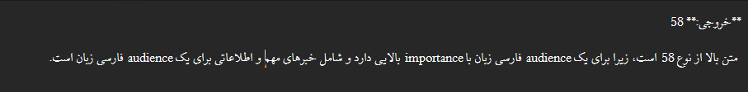
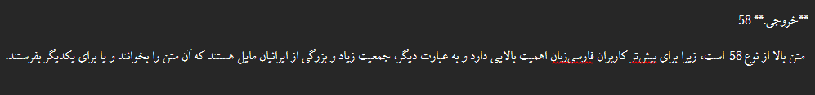
Symbol Tuning Gemma-7b-it
Result 321, k = 1:
Result 321, k = 5:

Slide 52
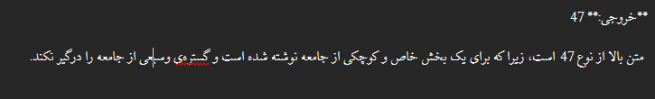
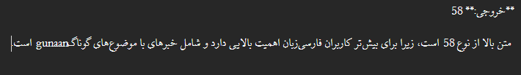
Symbol Tuning Gemma-7b-it
Result 321, k = 20:
Result 321, k = 50:

Slide 53
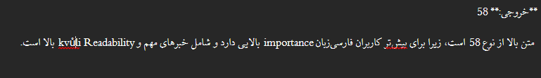
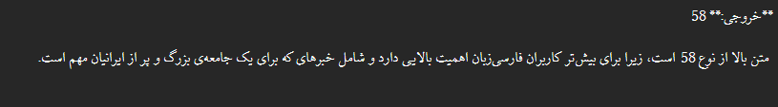
Symbol Tuning Gemma-7b-it
Result 381, k = 1:
Result 381, k = 5:

Slide 54

Symbol Tuning Gemma-7b-it
Result 381, k = 20:
Result 381, k = 50:

Slide 55
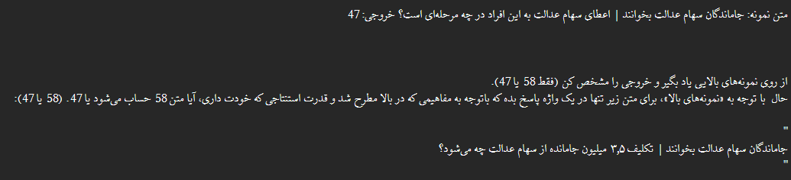
Symbol Tuning Gemma-7b-it Prompt
Result 261, k = 1:

Slide 56
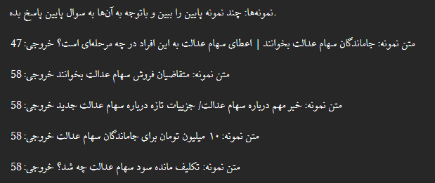
Symbol Tuning Gemma-7b-it Prompt
Result 261, k = 5:

Slide 57
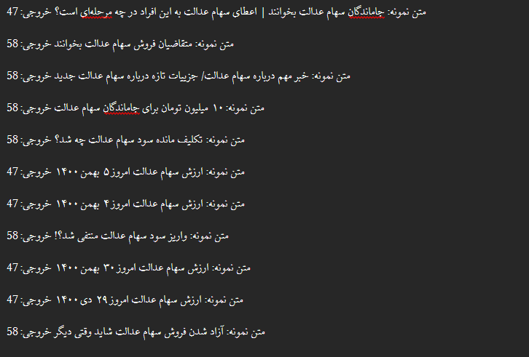
Symbol Tuning Gemma-7b-it Prompt
Result 261, k = 20:

Slide 58
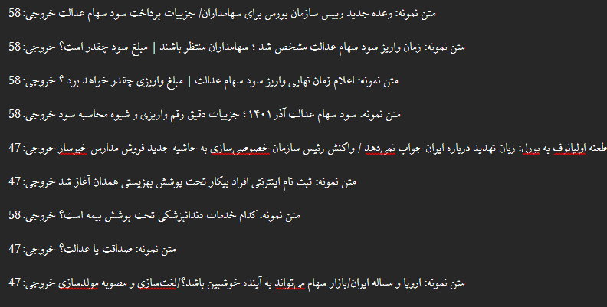
Symbol Tuning Gemma-7b-it Prompt
Result 261, k = 20:

Slide 59

Symbol Tuning Gemma-7b-it
Result 261, k = 1:
Result 261, k = 5:

Slide 60
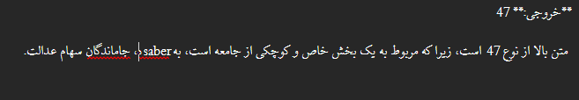

Symbol Tuning Gemma-7b-it
Result 261, k = 20:
Result 261, k = 50:

Slide 61
Symbol Tuning Gemma-7b-it
It seems that the reasoning is inconsistent across different k shot learning prompts.
The model is very sensitive to the example provided, especially in k=1 situation.
We see that a mix of English and Persian words is generated in response.
There is a theory that these small LLM models (parameters < 9b) are having better performance in reasoning task in English compared to Persian.
As it seen in one of results, the model tried to provide reason in English langue, while the whole prompt is in Persian.
It is worth experiencing with having instructions in English language and the examples and target text in Persian.

Slide 62
System-User Prompt Design
One way to increase the performance of the model is to use System-User Prompt structure.
In this way, the system prompt is constructed around defining the task and what model should generate.
The user prompt is considered as the prompt given by the user.
The system prompt is mostly unchanged throughout the iterations and user prompt is always dynamic.

Slide 63
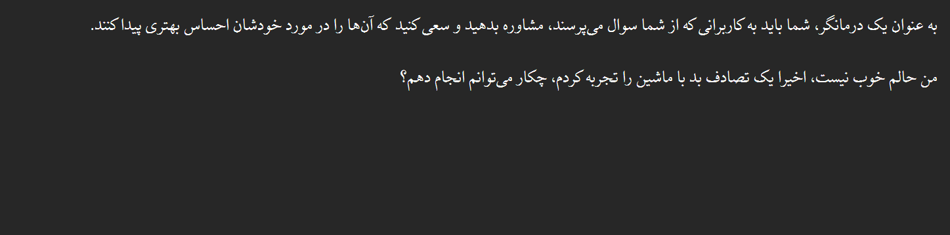
System-User Prompt Design
The input prompt which is only in Persian language:
Without the use of any system-user prompt instruction.

Slide 64
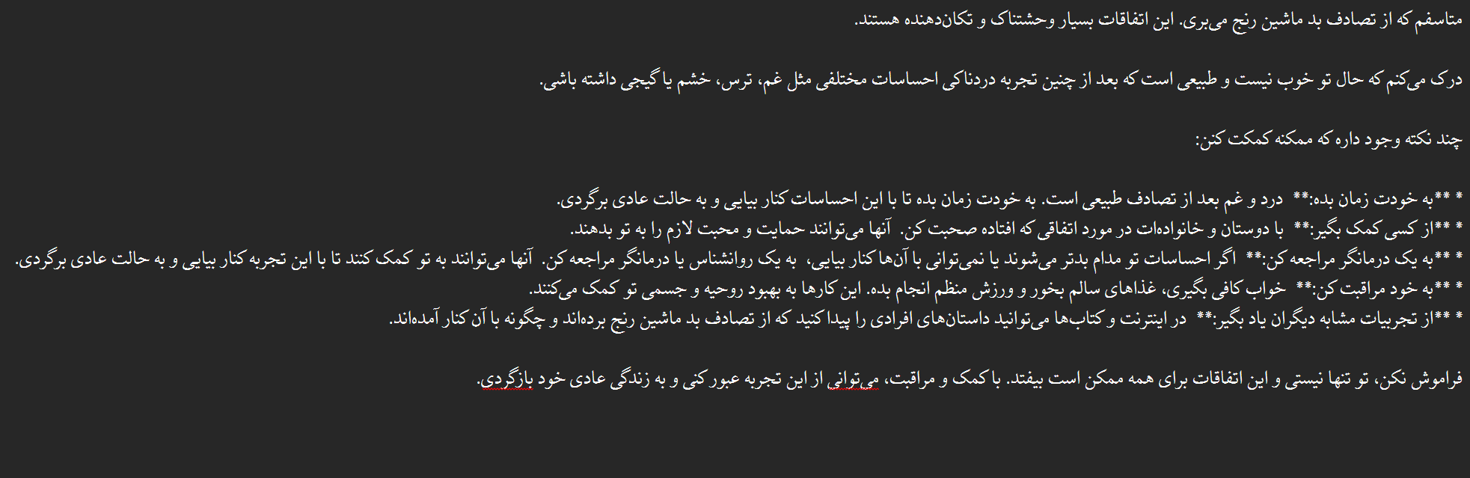
System-User Prompt Design
And this is the result form Gemma2 9b it:
Which is quite acceptable

Slide 65
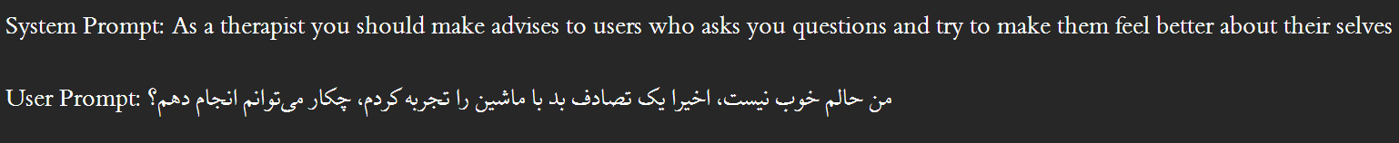
System-User Prompt Design
Now we changed the input prompt to have system-user instruction.
In a way that System prompt being in English language and the user prompt being in Persian language.
This is due to the reason that the model can understand instructions better in English language and have a better reasoning in that situation.

Slide 66
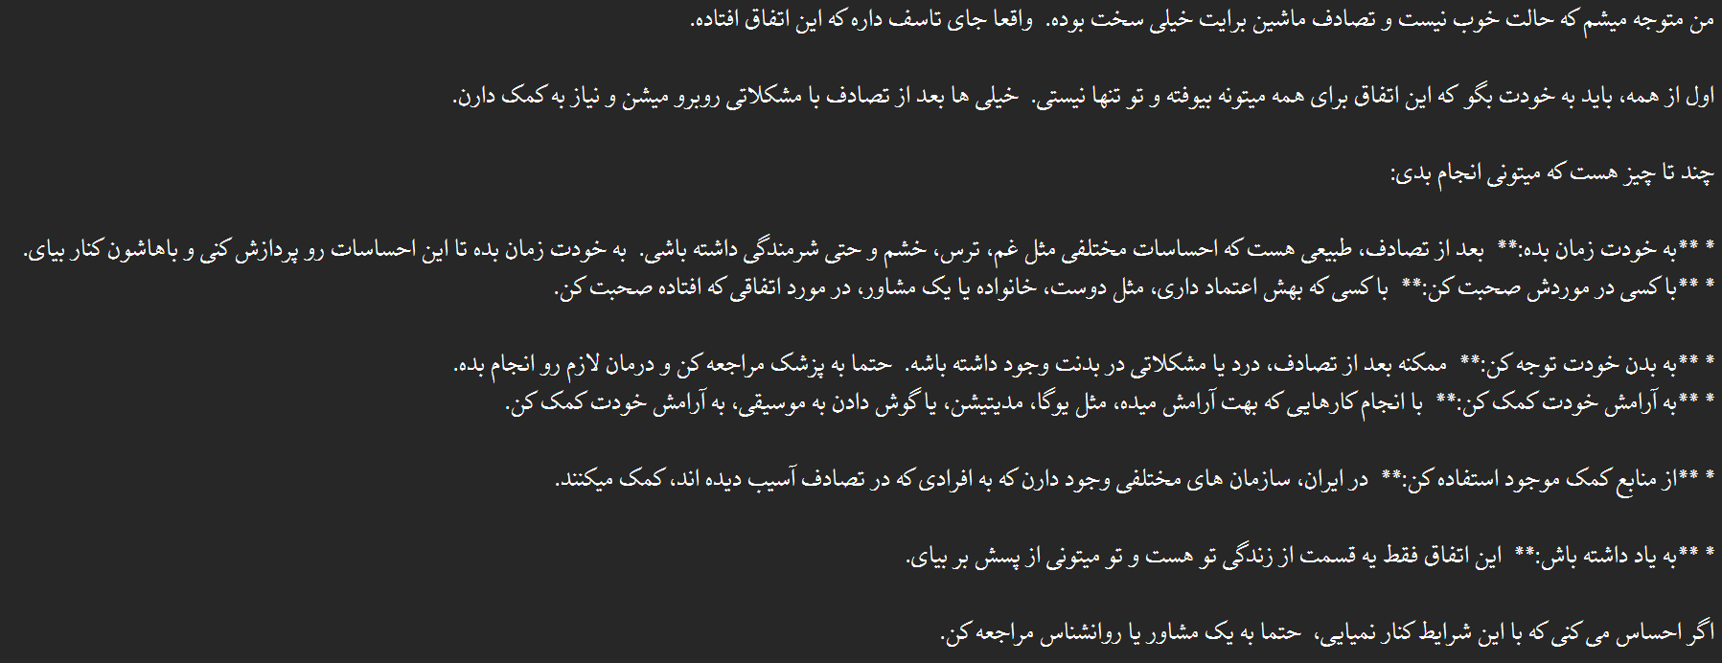
System-User Prompt Design
This the result form Gemma2 9b it for changed prompt:
Not only the reference time was 2x faster, but also the results became more natural and enhanced.

Slide 67
System-User Prompt Design
As the result of the little experience conducted, it is worthwhile to test the system-user prompt design with system prompt being in English (including the k-shot examples in Farsi) and the user prompt being the same.
In that case it is feasible to not repeat the instructions due to the better understanding of the model.

Slide 68
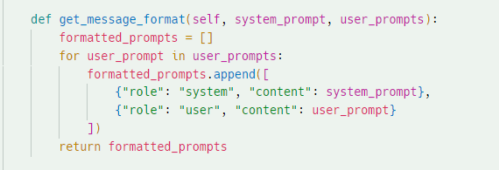
System-User Prompt Results
Now for this part, we changed the code in a way that accepts both roles of ‘user’ and ‘system’.
It should be mentioned that gemma2 doesn’t support any other role than ‘user’.

Slide 69
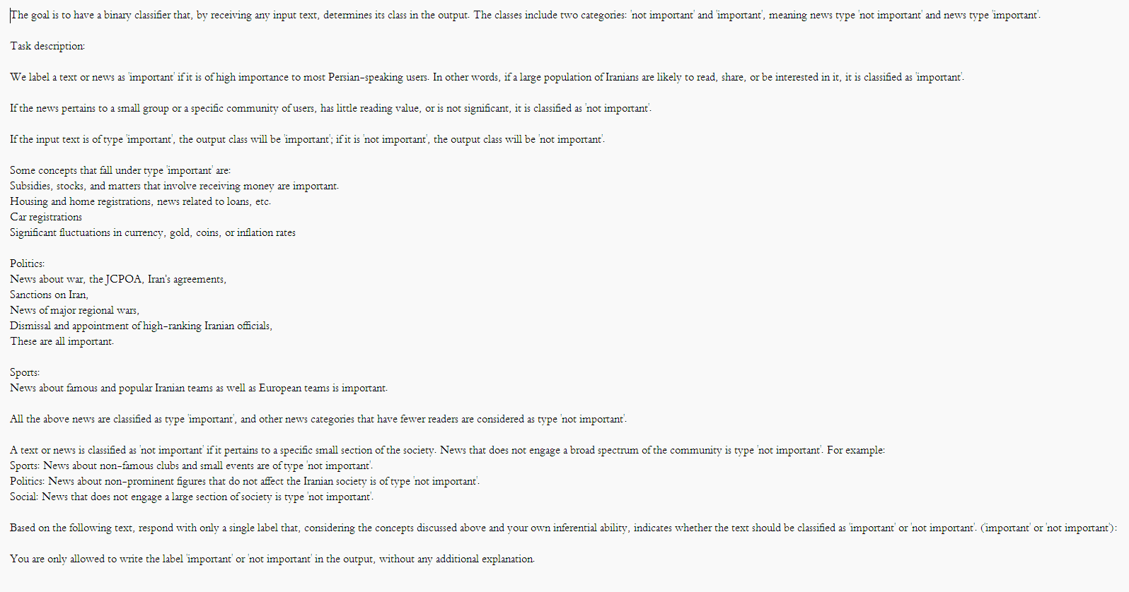
System-User Prompt Results
Moreover, we changed the system prompt to English and maintained the input and samples in Persian.

Slide 70
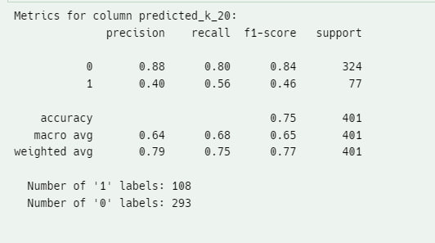
System-User Prompt Results
The shown figure illustrates the result for the first 400 samples with k=20 shot learning and in only title mode.
Here the ‘important’ and ‘not important’ labels are used.

Slide 71
System-User Prompt Results
In conclusion, it seems that both ‘system-user’ prompt design and using English system prompt result in better performance.
It is highly possible that the model has better reasoning power in English rather than Persian.

Slide 72
System-User Prompt Results
In further step, we changed the labels to ‘0’ and ‘1’s and here is the results.
As we can see there are fewer ‘1’ label predicted hence the overall f1-score saw a increase.

